Slide 1
Explainable AI-Based
Automated Data Quality
Management System
for Noise Detection in Numerical Data Pipelines
Presented by: Priya Dharshini V | M.Sc Information Technology | Guide: Dr. A. Akila

Slide 2
Abstract
🗄️
🤖
🗳️
💡
📊
Noisy Data
ML Models
Voting
SHAP
Dashboard
Real-world numerical datasets suffer from noise, outliers, and anomalies that reduce ML model reliability.
This system automates data quality management using an ensemble of three unsupervised ML models.
A consensus voting mechanism combines Isolation Forest, LOF, and One-Class SVM predictions.
SHAP explainability provides feature-level reasoning for every flagged anomaly.
A Streamlit dashboard offers an interactive interface for upload, analysis, and visualization.

Slide 3
Problem Statement
The Core Problem
⚠ No Explainability
Numerical data pipelines contain hidden noise and anomalies.
Manual detection is slow, inconsistent, and not scalable.
Existing tools detect anomalies but cannot explain them.
Single-model approaches produce high false positive rates.
Tools flag anomalies but don't say WHY
⚠ No Automation
Engineers still do manual inspection
⚠ No Consensus
Single models are unreliable alone
✓ Solution: An Automated, Explainable, Multi-Model Data Quality System

Slide 4
Literature Review
Breunig et al.
2000
Introduced LOF — density-based local outlier detection
Liu et al.
2008
Proposed Isolation Forest for efficient anomaly isolation
Schölkopf et al.
2001
One-Class SVM for novelty detection with kernel boundary
Lundberg & Lee
2017
Introduced SHAP — unified framework for model explainability
Various
2022
Ensemble voting shown to outperform single-model detection
Research Gap: No existing system combines ensemble detection + SHAP explainability in a unified pipeline.

Slide 5
Objectives
Automate Noise Detection
Ensemble ML Models
01
02
Build an end-to-end pipeline from raw data to clean output
Integrate Isolation Forest, LOF, One-Class SVM
Consensus Voting
SHAP Explainability
03
04
Flag anomalies only when majority of models agree
Generate feature-level explanations for every anomaly
Interactive Dashboard
Modular Architecture
05
06
Build Streamlit UI for upload, results, and visualization
Design reusable Python modules for easy extension

Slide 6
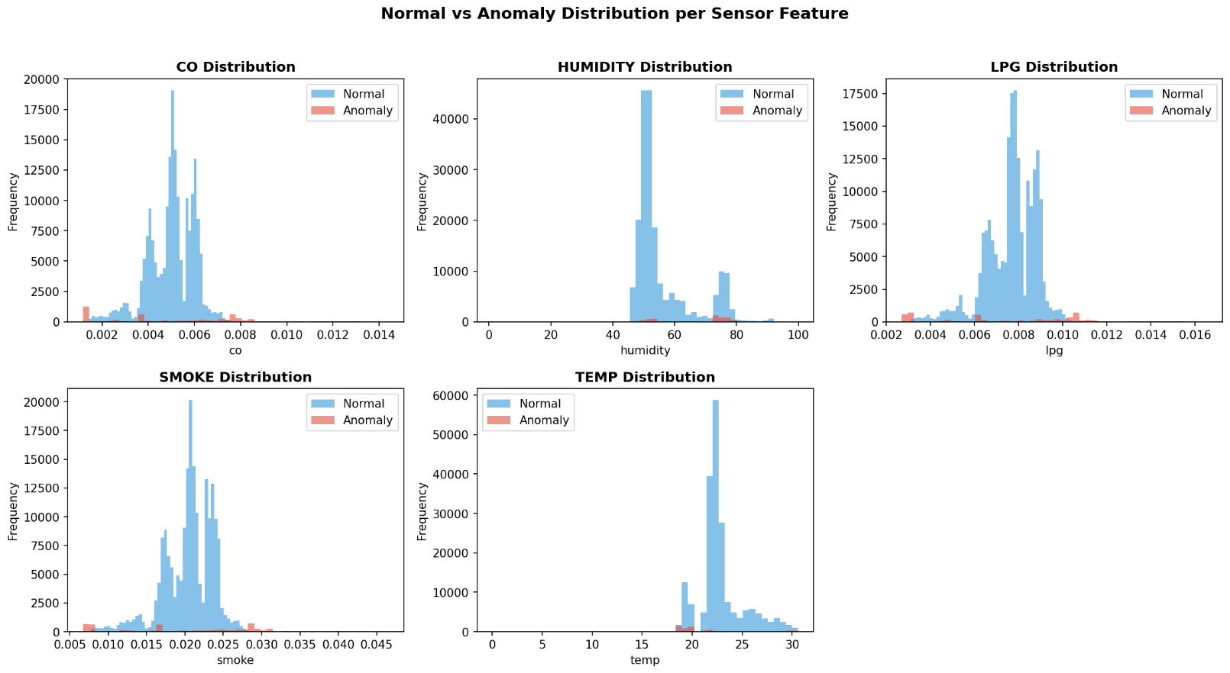
Dataset Description
Dataset Overview
10–50
1K–10K
Type: Numerical tabular datasets (CSV format)
Source: UCI ML Repository / Kaggle benchmarks
Features: Multi-dimensional continuous variables
Anomaly ratio: ~5–15% synthetic noise injection
Features
Records
5–15%
CSV
Anomaly %
File Format
Preprocessing Steps
Handle missing values (mean/median imputation)
Normalize features using StandardScaler
Remove duplicate records before analysis
[ Sample Dataset Visualization / Distribution Plot ]

Slide 7
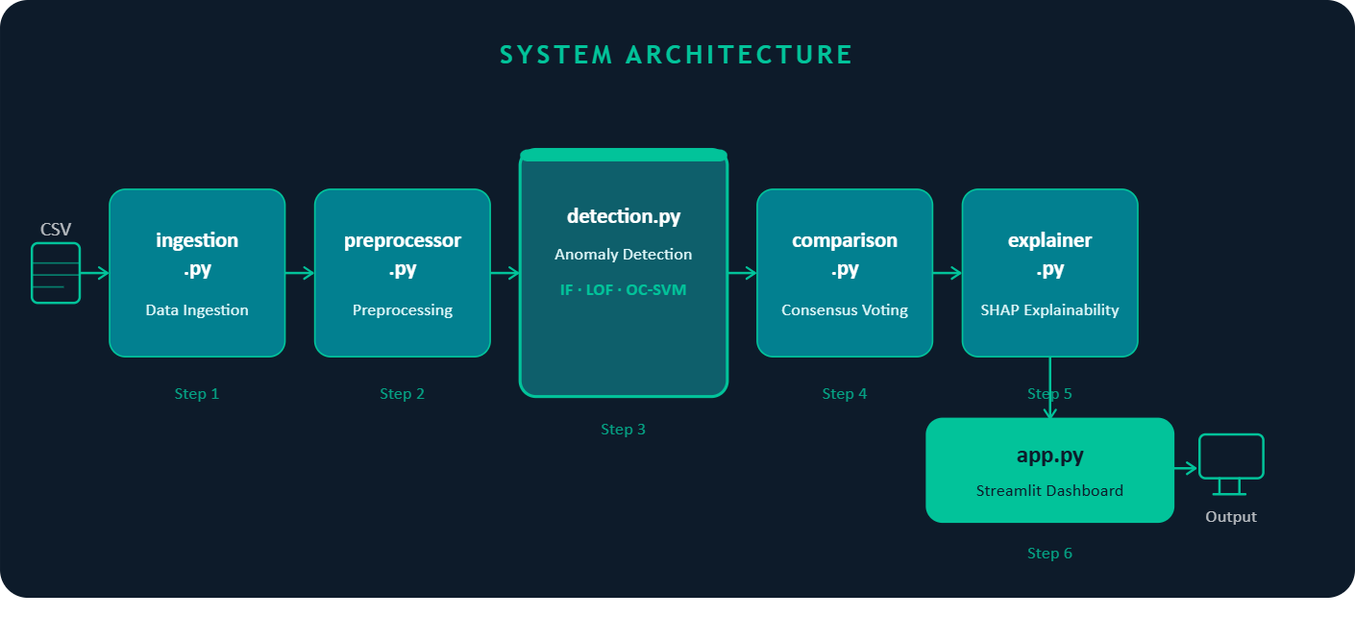
System Architecture
6 Python Modules
app.py
Entry point
ingestion.py
File upload & display
preprocessor.py
Data cleaning
detection.py
ML model engine
comparison.py
Consensus logic
explainer.py
SHAP generation
Output → Annotated Dataset + SHAP Visualizations + Quality Report

Slide 8
System Workflow
1
2
3
4
5
📤
🔧
🤖
🗳️
💡
Upload
CSV
Preprocess
Data
Run ML
Ensemble
Consensus
Voting
SHAP &
Report

Slide 9
Implementation Modules – Part 1
app.py
Initializes Streamlit application
Coordinates module calls and page routing
Manages session state across views
Main Entry Point
ingestion.py
CSV file upload widget
Displays raw and processed data tables
Renders results and download buttons
User Interface
preprocessor.py
Handles missing values with imputation
Applies StandardScaler normalization
Removes duplicates and invalid rows
Data Preprocessing

Slide 10
Implementation Modules – Part 2
detection.py
Trains Isolation Forest, LOF, One-Class SVM
Returns anomaly scores per model per record
Configurable contamination parameter
ML Detection Engine
comparison.py
Aggregates predictions from all 3 models
Flags record as anomaly if ≥ 2 models agree
Outputs final anomaly label + confidence count
Consensus Voting
explainer.py
Computes SHAP values using TreeExplainer / KernelExplainer
Generates force plots for flagged records
Renders plots via matplotlib + st.image in Streamlit
SHAP Explainability

Slide 11
Machine Learning Models Used
Tree-Based
Density-Based
Boundary-Based
Isolation Forest
Local Outlier Factor (LOF)
One-Class SVM
Isolates anomalies by randomly partitioning features
Anomalies are isolated in fewer splits than normal points
Fast and effective for high-dimensional numerical data
Unsupervised, no labeled data required
Compares local density of a point with its k-nearest neighbors
Points with significantly lower density = outliers
Detects context-sensitive / local anomalies
Effective when anomalies cluster differently from normals
Learns a kernel-based boundary around normal data
Points outside boundary flagged as anomalies
Handles non-linear distributions with RBF kernel
Works well when normal class is well-defined

Slide 12
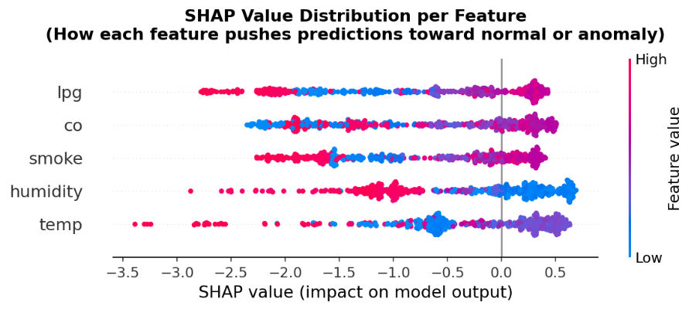
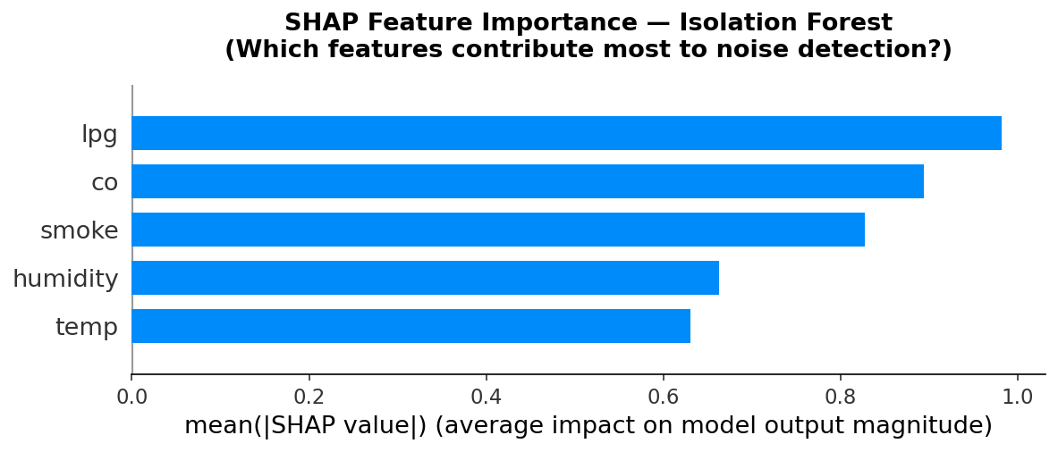
Explainability using SHAP
What is SHAP?
SHapley Additive exPlanations from cooperative game theory
Assigns each feature a contribution value for a prediction
SHAP values are consistent, locally accurate, and additive
Works with any ML model (model-agnostic)
[ SHAP Force Plot – Sample Output ]
How it's used in this project
[ SHAP Summary / Bar Chart ]
Force plots show which features pushed toward anomaly
Rendered via matplotlib savefig + Streamlit st.image()
Generated per flagged record in explainer.py

Slide 13
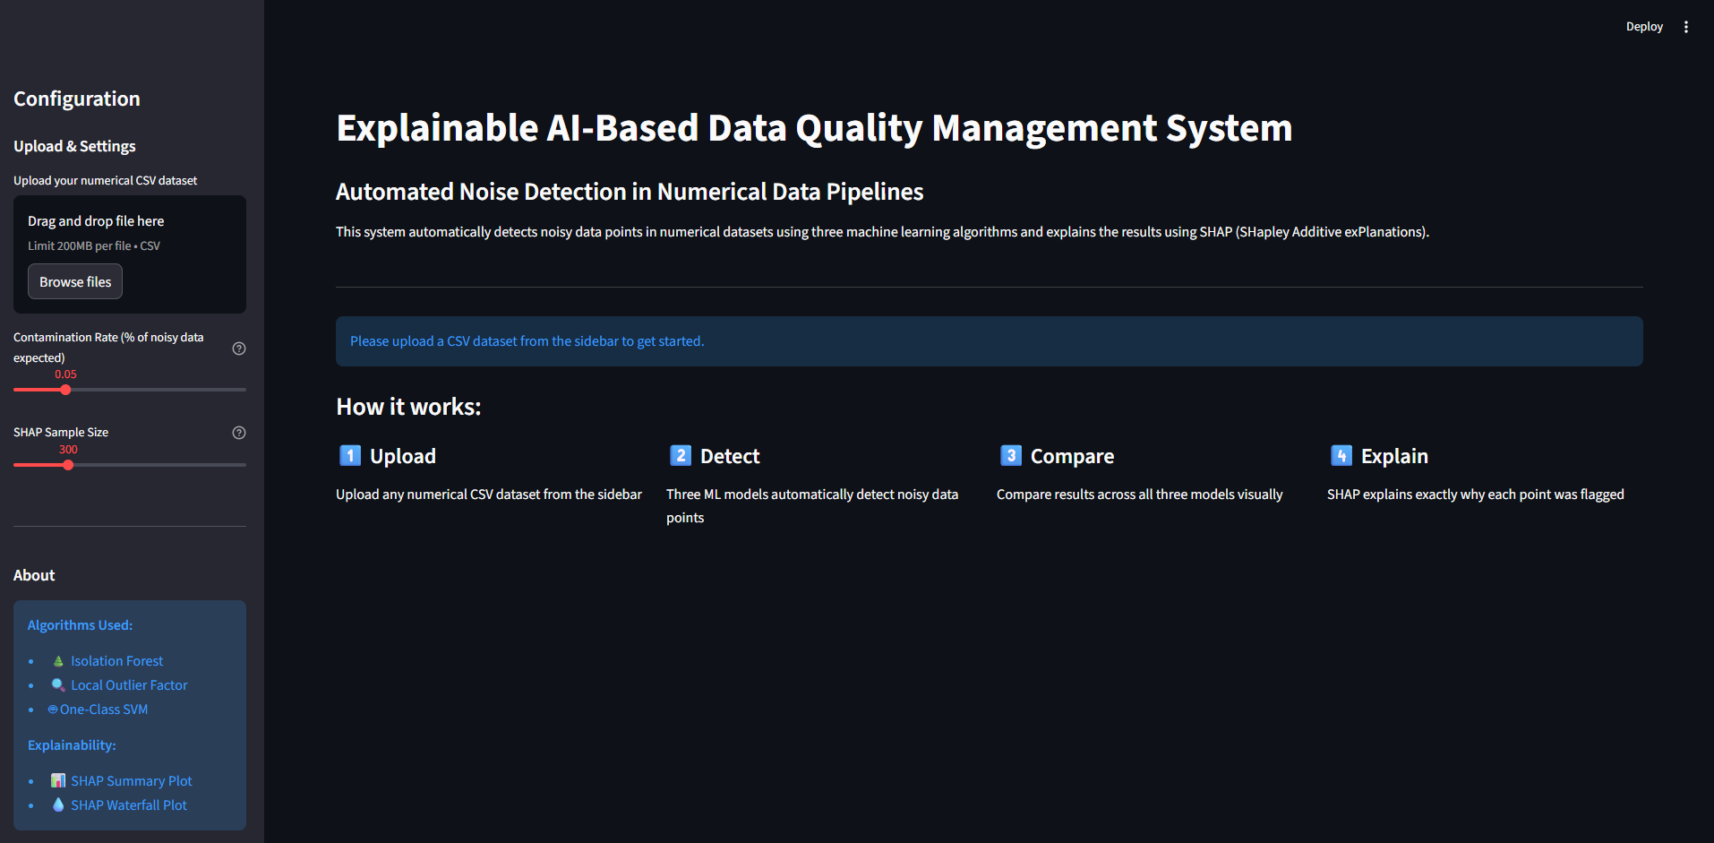
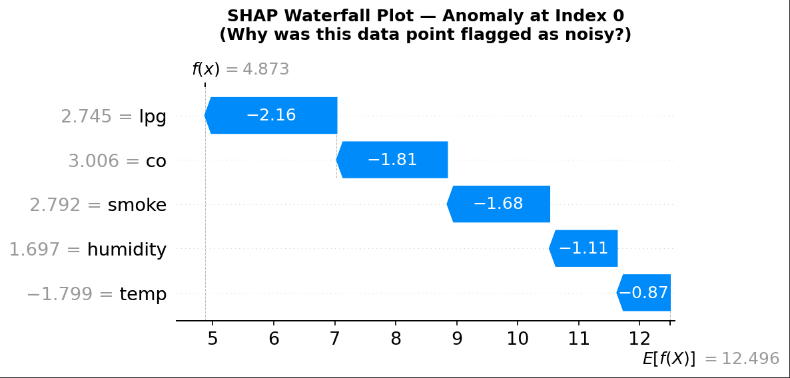
Results and Output
3
>85%
SHAP
6
Models
Combined
Target
Accuracy
Per-Record
Explanation
Python
Modules
[ Application Screenshot – Dashboard ]
[ Application Screenshot – Results / SHAP View ]

Slide 14
Conclusion & Future Work
Conclusion
Future Work
Successfully built an automated data quality pipeline
Ensemble of 3 models improves detection reliability
Consensus voting reduces false positive rate
SHAP makes results transparent and trustworthy
Streamlit dashboard makes it accessible to all users
Support for categorical and time-series data
Add deep learning models (Autoencoder, LSTM)
Real-time streaming pipeline with Apache Kafka
Plotly interactive visualizations in dashboard
Deploy as a REST API for enterprise integration
Thank You | Open for Questions & Feedback

